Slide 1

PowerPulse: Household Energy Usage Forecast
A Machine Learning Project on Energy Consumption Prediction

Slide 2
INTRODUCTION
Domain Introduction: Energy Consumption Forecasting
The growing demand for electricity requires efficient energy planning.
Household energy usage forecasting helps:
Reduce energy wastage
Optimize supply and demand
Predictive modeling can assist users and providers in making data-driven energy decisions.
Tools & Technologies Used:
Tool | Purpose
Python | Programming language
Pandas | Data manipulation & preprocessing
Matplotlib / Seaborn | Visualization tools
Scikit-learn | Machine learning models & evaluation
Jupyter Notebook | Development environment

Slide 3
OBJECTIVE
Problem Statement:
Accurate energy consumption forecasting is essential for smarter household management and efficient grid planning. This project aims to build a predictive machine learning model that uncovers usage trends and supports optimized energy decisions.
Dataset Overview:
Source: UCI Machine Learning Repository / Kaggle
Granularity: 1-minute level household power usage
Timeframe: Covers several years
Records: ~2 million rows (approx.)
Features:
⚡ Global_active_power: Target variable (kW)
🔁 Global_reactive_power: Power that doesn't do useful work
🔌 Voltage, Global_intensity
📍 Sub_metering_1: Kitchen
🧺 Sub_metering_2: Laundry
💧 Sub_metering_3: Water heater & AC

Slide 4
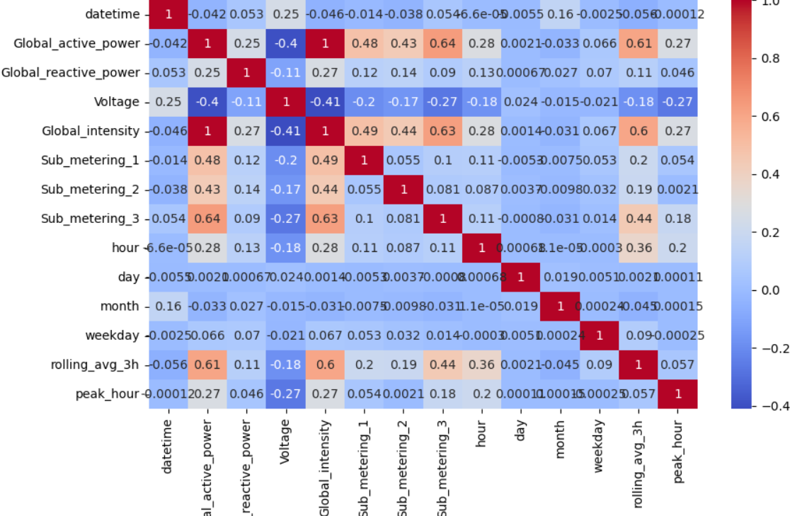
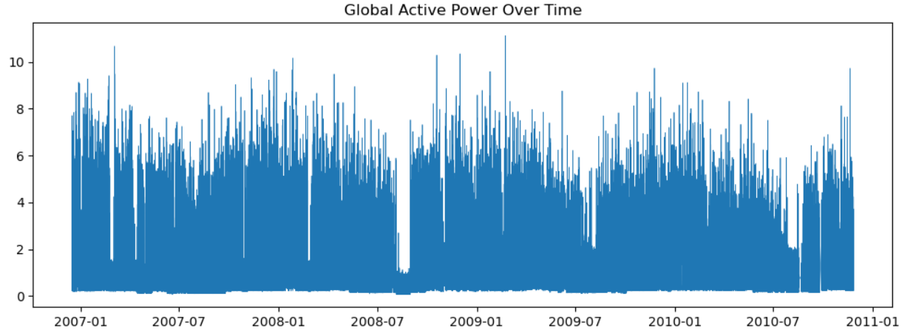
DATA ANALYSIS & FEATURE ENGINEERING
Data Preprocessing & Feature Engineering:
Handled missing values ( like NaN)
Parsed datetime → Extracted hour, day, month, weekday
Created rolling averages and peak hour flag
Scaled or normalized where necessary
Visuals:
1. Heatmap of correlations 2. Sample line plot of Global Active Power over time

Slide 5
MODEL BUILDING & SELECTION
Model Selection & Training:
Models trained:
Linear Regression
Random Forest Regressor
Gradient Boosting Regressor
Train/Test Split: 80/20
Selected features: Hour, Voltage, Intensity, etc.
Target Variable: Global_active_Power
Input Features:
Time-based: Hour, Day, Month
Electrical: Voltage, Global Intensity
Flags: Peak hour, Rolling averages

Slide 6
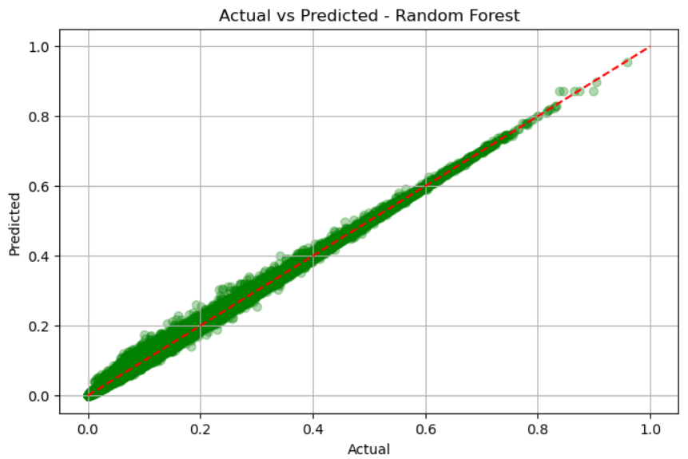
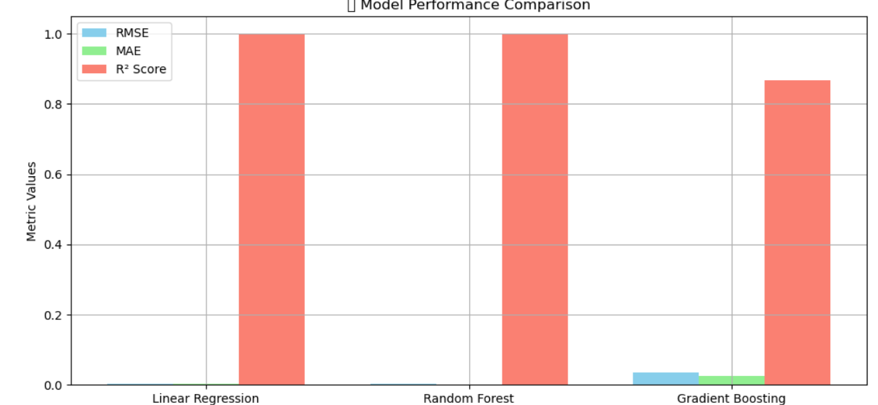
MODEL EVALUATION
Model Evaluation Results:
Table:
Visuals: 1. Actual vs Predicted Scatter Plot 2. RMSE Comparison Bar Chart
Model | RMSE | MAE | R² Score
Linear Regression | 0.0039 | 0.0026 | 0.9983
Random Forest | 0.0029 | 0.0013 | 0.9990
Gradient Boosting | 0.0347 | 0.0262 | 0.8684

Slide 7
KEY INSIGHTS
Insights from Data & Model:
Power usage peaks during 6–9 AM and 6–9 PM
Voltage and Global Intensity strongly affect power consumption
Kitchen and water heater consume significant energy (shown via sub-metering)
Weekends exhibit slightly different usage patterns
Random Forest performs best for accurate forecasting
Energy-saving opportunities exist during identified peak hours by optimizing appliance usage.

Slide 8
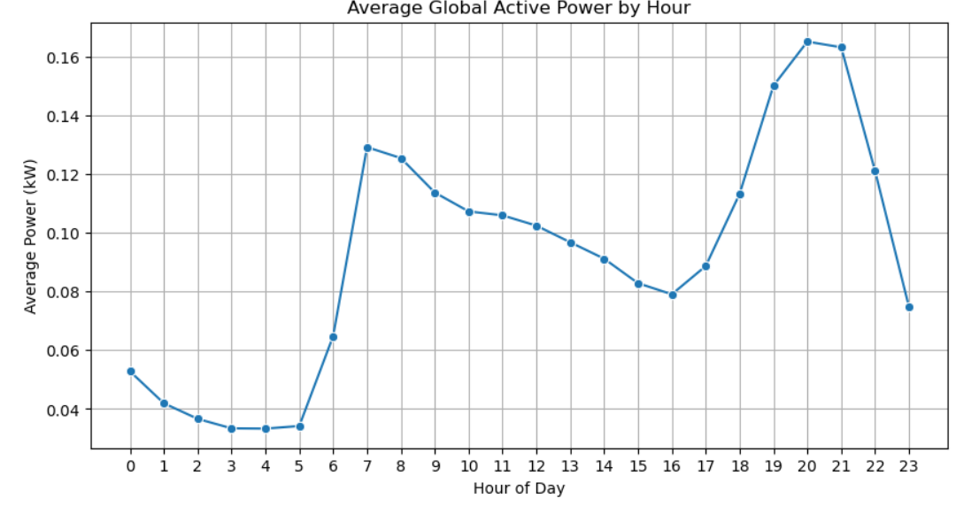
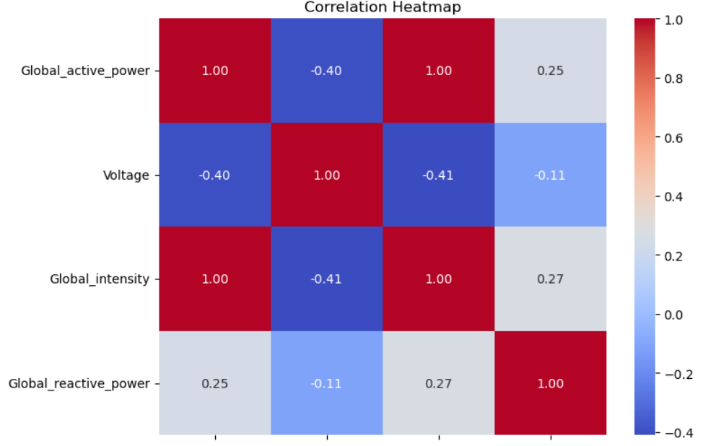
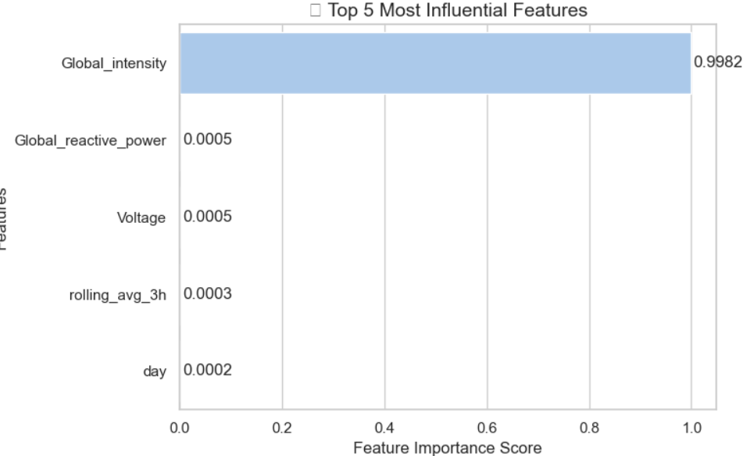
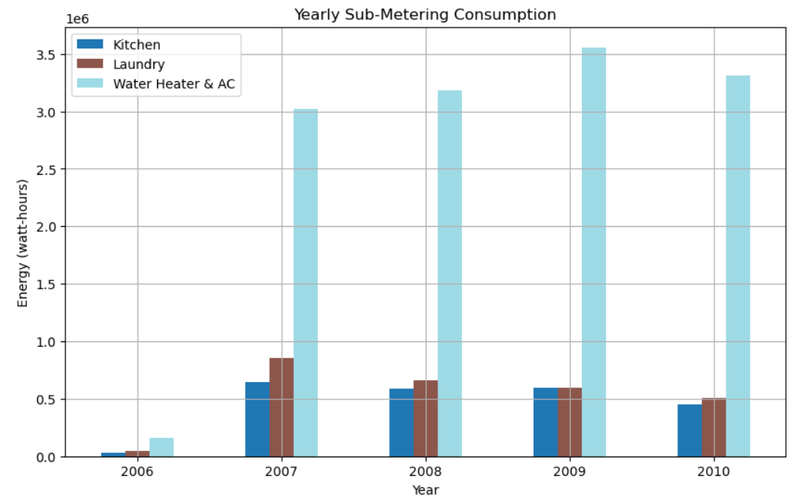
VISUALIZATIONS Visual Insights from Analysis and Modeling:

Slide 9
FINAL RECOMMENDATIONS
Conclusion & Summary:
Successfully built and evaluated machine learning models to predict household energy consumption.
Random Forest Regressor emerged as the most accurate model with an R² Score of 0.9990, indicating high reliability.
Data analysis revealed key trends such as peak hour consumption, feature influence, and high-usage appliances.
Key Takeaways:
⚡ Voltage, Global Intensity, and time-based features are strong predictors of energy usage.
📊 Sub-metering analysis revealed that water heaters and air conditioners are the most energy-intensive appliances.
🔄 Predictive modeling enables data-driven decisions for smart energy management and optimization.
💡 This project showcases the practical use of machine learning in solving real-world energy challenges — helping both consumers and providers move toward smarter, greener energy solutions.

Slide 10
THANK YOU!

